Slide 1
Electric Bicycle Project
Alec Korver | Chris Slice | Bryan Hanenburg
Professor De Boer - Project Mentor
Professor Schuurman - Customer
Notes:
Good afternoon everyone, Alec Korver, Chris Slice, and I, Bryan Hanenburg are the electric bike design team.

Slide 2
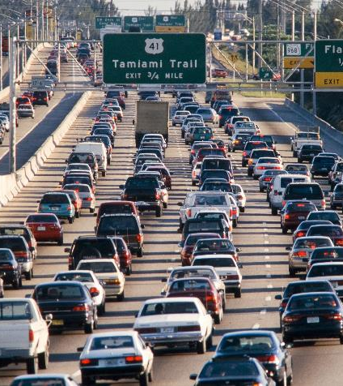
Introduction
Problem
Inefficient
Pollutes Environment
Expensive
http://cdn.zmescience.com/wp-content/uploads/2013/09/traffic.jpg
Notes:
According to the United States Department of Transportation the average driver travels 29 miles per day. Nearly 90% of these daily trips are taken in personal motor vehicles. For most people, comfort, time, and convenience are the most important factors in determining how they travel each day. These preferences often equate to each person driving a heavy and inefficient vehicle to work or school. By doing so we waste 90 times more energy that if we walk or bike. This not only pollutes the air around us, but can be a significant expense as well. Being mindful of this wastefulness is an excellent start, but most people also need faster travel alternatives than running or biking.

Slide 3
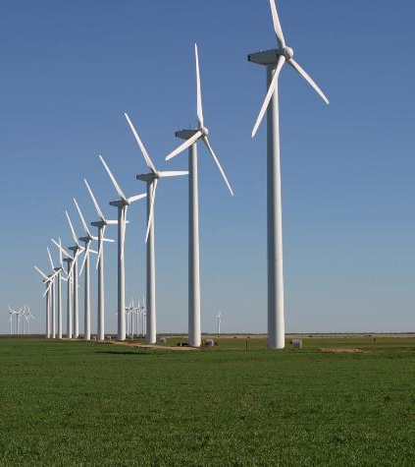
Introduction
Solution
Eco-Friendly
Enjoyable
Affordable
Healthy
http://www.energybc.ca/images/profiles/wind/windfarm.jpg
Notes:
Our team’s goal was to address these shortcomings by offering an realistic, yet attractive solution. We did not want to reinvent the wheel, but to use existing technology to create a more eco-friendly, enjoyable, affordable, and healthy alternative.

Slide 4

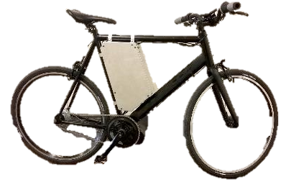
Introduction
Our Electric Bicycle
Eco-Friendly
Enjoyable
Affordable
Healthy
Notes:
Our solution is FLUX.
FLUX is an electric bicycle that we designed, simulated, and built for use in Northwest Iowa. Flux is an improvement to the everyday drive and it was hand built using primarily off the shelf components. Because of this we are able to make sure that the final product is, durable, quick to assemble, low maintenance, and easy to repair. But to ensure that the components we chose were ideal for our application, we needed to follow a systematic approach so that we would have a favorable outcome.

Slide 5
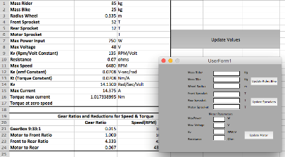
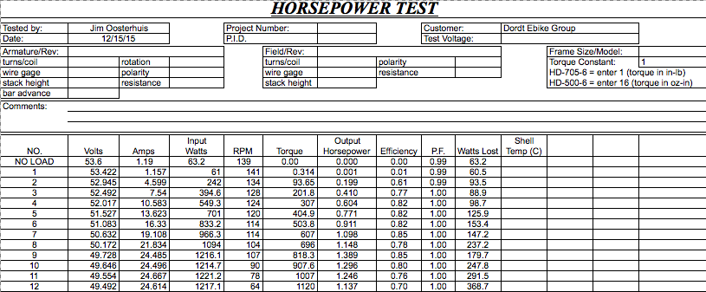
Introduction
Our Approach
Computer Simulation
Bike Design
Design Verification
Notes:
To achieve this, we first created a computer simulation that took into account all the individual pieces of the bicycle to see what worked best. We then created the bicycle from the parts we chose, and conducted various tests to ensure that the simulation was accurate, and that the bike performed as expected.

Slide 6
Early Design Simulation
What is a simulation?
Virtual (Computer based) representation of our bicycle design.
What does it do?
Helps predict maximum range, top speed, and battery consumption.
Notes:
So what is a simulation? A simulation is a virtual or computer based program which can be used to mathematically model real world objects or phenomenon. In the context of our project our simulation helps us compare many different bicycle designs and helps us to determine how far the bike will go, how fast you can travel, and how much battery power will be used. [next slide]

Slide 7
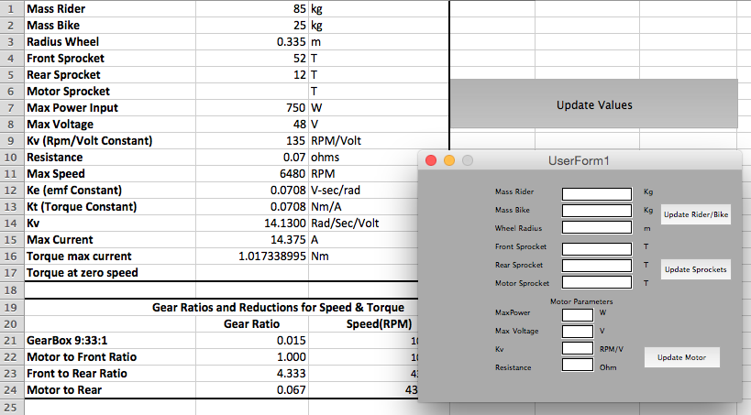
Early Design Simulation
Notes:
Our first program was Aptly named Early Simulation. This simulation focused on providing an in depth understanding of the operational physics of various electric bicycle configurations by allowing us to tweak wheel size, gearing ratios, motor types, and battery voltages. Early Simulation allowed us to model and test multiple electric bicycle designs. Early simulation allowed us to change the variables in order to evaluate the bicycle as a whole. Each design was run on a “riding profile” and the differences in efficiency, top speed, time it took to complete, were compared. [next slide]

Slide 8
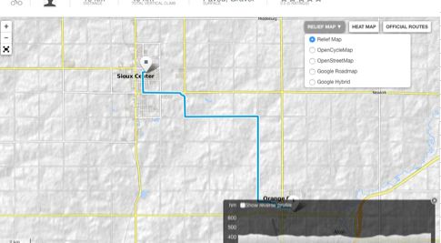
Early Design Simulation
Notes:
For our early design and simulation phase we used a riding path from orange city to sioux center. We were able to easily determine the performance differences between our various bicycle designs by comparing all of our designs against this same riding profile.

Slide 9
Notes:
Additionally, Early Simulation allowed us to look at torque speed curves of different bicycle gearing ratios. From this graph we can also see where each gearing step falls in its associated power band. With higher RPMS being associated with higher efficiency levels and lower RPMs being associated with more torque. After the accuracy of Early Simulation was verified, we then proceeded to develop our web based simulation.[next slide]

Slide 10
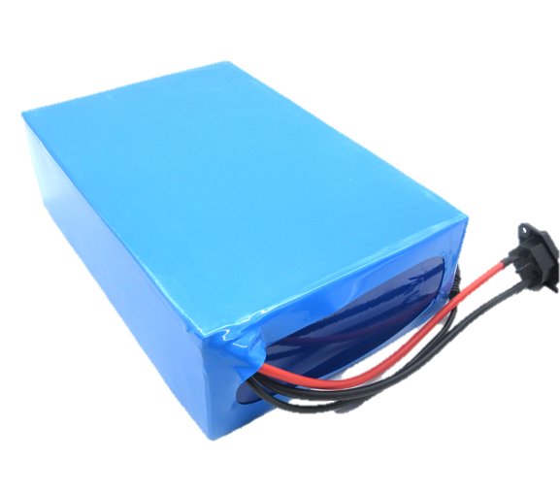
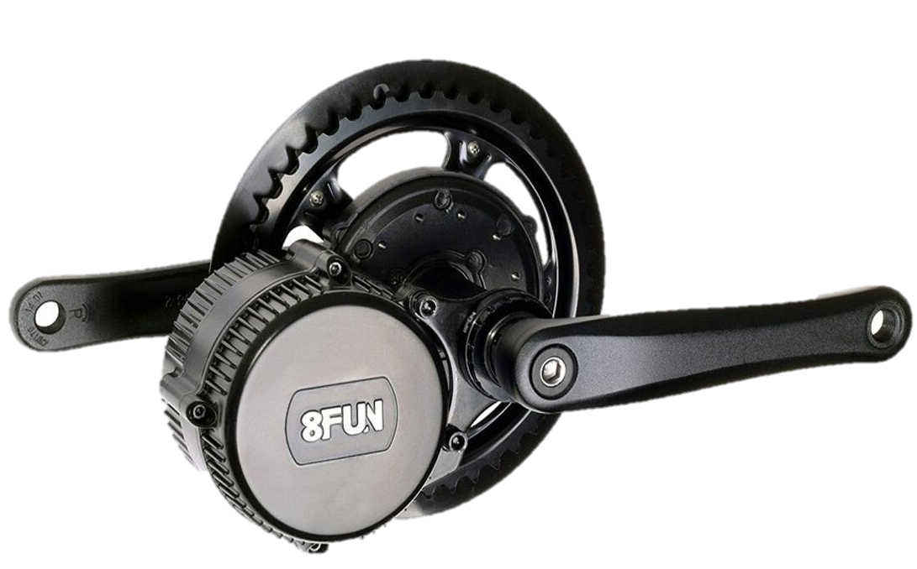
Web Based Simulation
What’s the purpose of our Web based Simulation?
Designing customizable bikes. Not everyone needs:
20Ah Battery
1300W motor
Provide trip data
Trip distance and time
Energy used, % battery
remaining
Notes:
Whats the purpose of our web based simulation?
It is a simplified version of our early simulation. It gives everyone the ability to simulate their unique bicycle on their unique commute. This is valuable for designers as well as users. Not everyone needs the 20ah battery or 1300 w motor that we used in our bike. Since this simulation is easily repeatable with variable parts, it allows us to determine the ideal configurations for different customers. We can determine what parts make the best bike for my parents, who might use the bike primarily in town, or for me, who might use it to make 20 mile trips to hull and back for Sunday dinner. We can guarantee that the bike will do what the customer need it too, and that customers aren’t paying more for a bike which provide a range or speed that they don’t use.
-This simulation served a double purpose by providing information to users. We believed it was necessary to provide this data to riders, and this simulationwas the best way to accomplish this goal within our allocated resources.

Slide 11
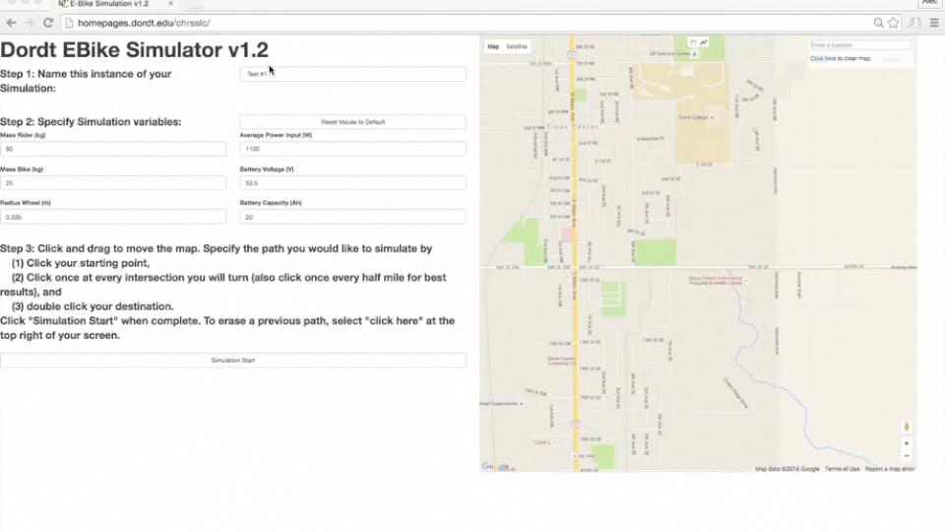
Web Based Simulation
Try it yourself at homepages.dordt.edu/chrsslc
Notes:
What about the program itself?
Start the video now
A User navigates to our webpage via any internet accessible device, and inputs the characterisitcs of their real or theoretical bicycle. They then choose their route from anywhere in the world . The user can, on a turn by turn basis, define their path. The program corrects the estimated route to fit the road’s twists and turns. This simulation is technically easy to use. It predicts and records the time and distance traveled and % battery reamining.

Slide 12
Web Based Simulation
How does it solve problems?
Minimizes
Cost
Maximizes Responsibility
Proves
Feasibility

Slide 13
Validation & Testing
Ensuring Accuracy
Tested potential commutes
Compared data to simulation
Ensured difference < 10%
Notes:
Since an inaccurate simulation is not useful to our potential users, we needed to ensure that it was accurate in a variety of conditions. We did this by attaching monitoring electronics between the motor and the battery, and then rode along potential commutes between Sioux Center, Orange City, and Hull. The results after each trip were recorded and then compared to the simulation. We hoped to keep the difference in energy consumption between the simulation and the tests under 10% due to the affect of wind and other road conditions. We consistently stayed within 5-7% of the predicted value, so we can safely conclude that the simulation is accurate.

Slide 14
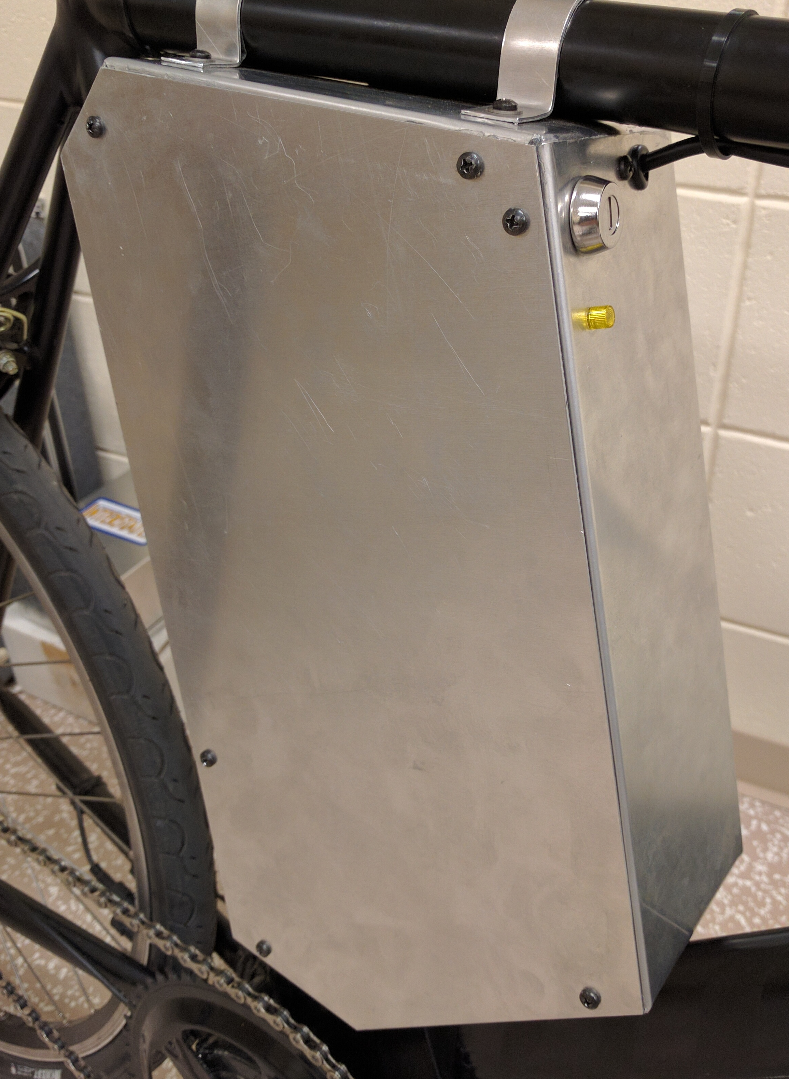
Battery Box
Needed to:
Protect the battery and electrical connections
Allow charging of battery
Have a keyed switch
Be waterproof
Notes:
The main piece of the bicycle unaffected by the simulation results, was the battery box. This is important for several reasons, as these increase the reliability, safety, and convenience of using the bicycle. The final design was a custom built aluminum box that fits into the center of the frame. This was chosen primarily due to a lack of commercially available options that fulfilled the requirements above, which were all easily obtainable with a custom solution.

Slide 15

Credit goes to Ben Kuiper for filming and editing this video.
Notes:
Bring out bike after promo video

Slide 16
Questions?

Slide 17
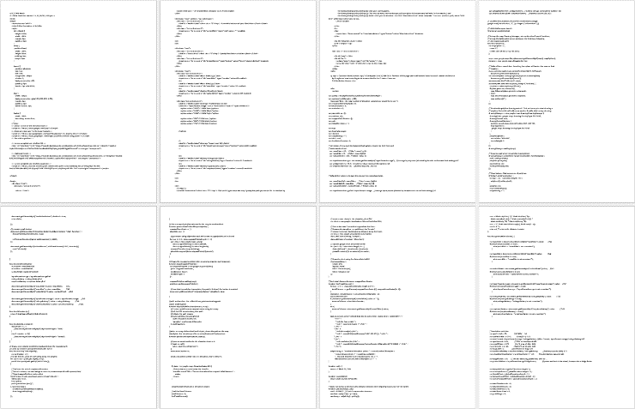

Slide 18
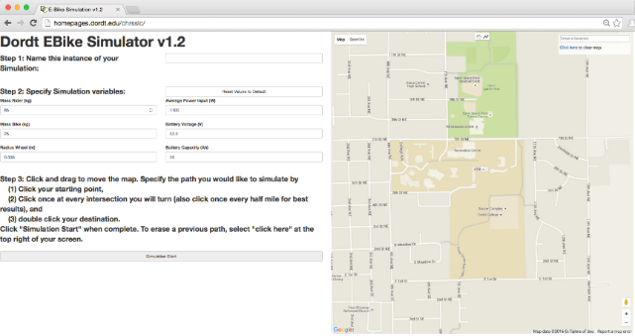

Slide 19
Groschopp Testing & Validation
Notes:
We used our testing as a means to increase our simulation accuracy

Slide 20
Final Design
750W Mid Drive Electric Motor
20.8 AH 52V Battery
Aluminum Battery Box
6061 Aluminum Frame
8-Speed Internally Geared Hub
26” Hybrid Commuter Wheels

Slide 21
Notes:
Knowing that we had an accurate model was important. From this we decided to develop a web based simulation.

